Slide 1

Capstone Project -
Smart Library Manager
Presented by:
Abhigna K Prasad(CGI08) and Gagana H(CGI08)

Slide 2

Introduction
Libraries need to track books and members easily.
•This project is a menu-based console app.
•Stores data in text files instead of a database
Operations involve:
Adding and removing books
Registering members
Borrowing and returning books
Maintaining accurate records
Goal is to build a console-based library management system using Python OOP with persistent storage using text files.

Slide 3
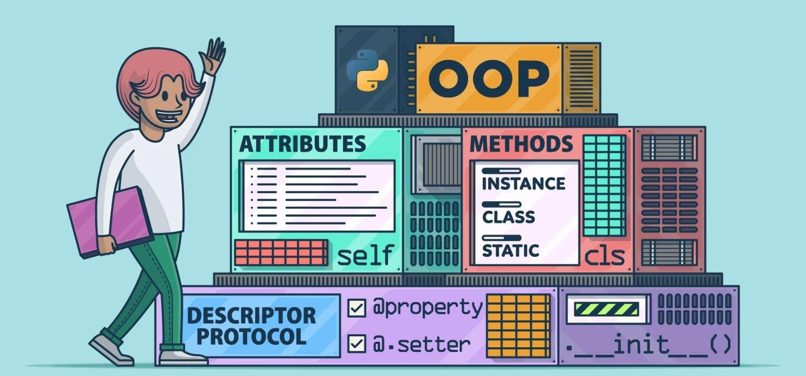
Objectives
Develop a menu-driven Library Manager using Python
Implement Object-Oriented Programming (OOP) concepts
Ensure data persistence with file handling (no DB required)
Build a modular and reusable code structure
Provide an easy-to-use CLI interface
Keep the system scalable for future upgrades (GUI, database)

Slide 4

Manual library systems are slow and error-prone
Tracking borrowed books is difficult without automation
No centralized records, causing data loss risks
Updating member details is tedious and inconsistent
Libraries need a lightweight offline solution
Full database systems are overkill for small libraries
Problem Statement

Slide 5

Easily manage books by adding, deleting, or viewing them
Handle member registration and information management
Track borrowing and returning of books with real-time status updates
Store all data persistently in text files (books.txt, members.txt)
Simple, interactive CLI menu for smooth navigation
Well-structured OOP design using Book, Member, and Library classes
Features

Slide 6
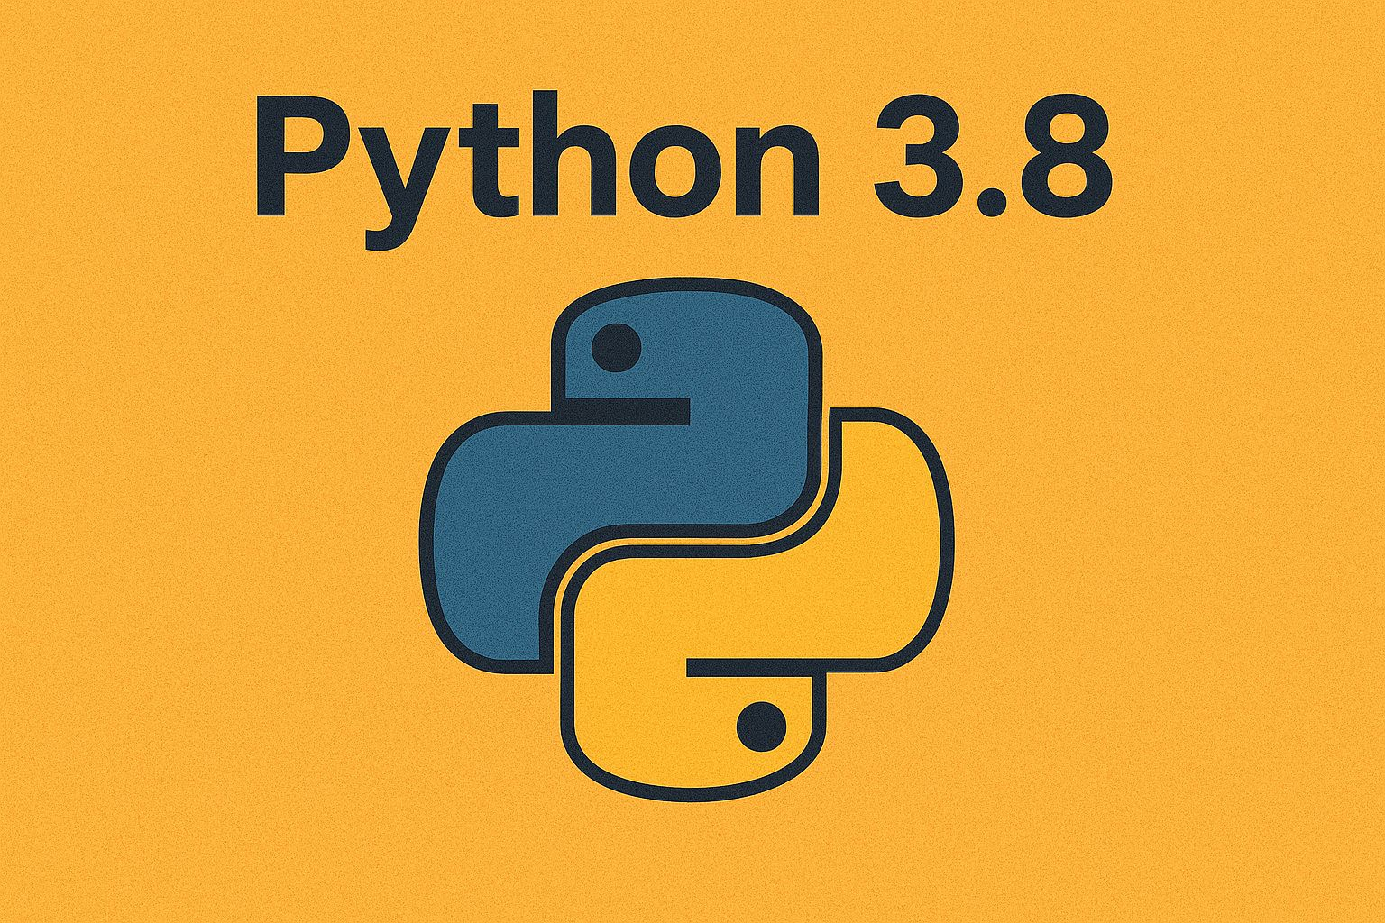
Requirements
Software used: Python 3.8
Knowledge Required:
Object-Oriented Programming (classes, objects, methods)
File handling (open, read/write, line parsing)
Dictionaries and Lists in Python
Type hints (from typing import Dict, List, Optional)

Slide 7

Requirements
Files Used:
books.txt – store book data
members.txt – store member data
Modules Used:
os – check file existence
typing – add type annotations

Slide 8
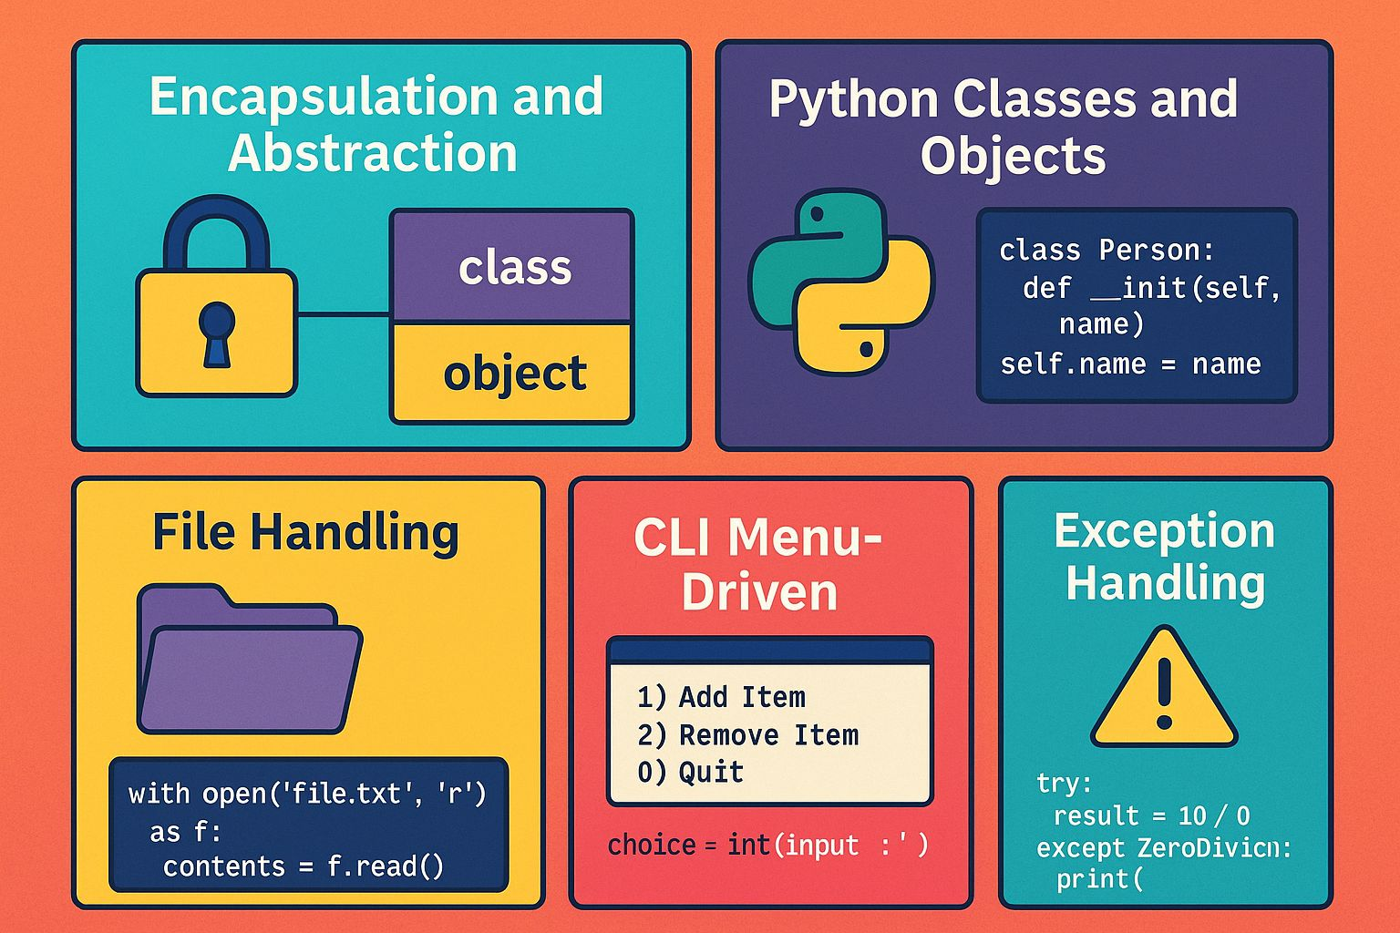
Python Classes and Objects
Constructors (__init__)
Instance methods and @staticmethod
Special methods (__str__)
Dictionaries and Lists as data containers
File Handling (open, read, write, strip, split)
Type Hints (Dict, List, Optional)
Exception Handling with ValueError
Encapsulation and Abstraction principles
CLI menu-driven programming
Topics Covered in this Project

Slide 9
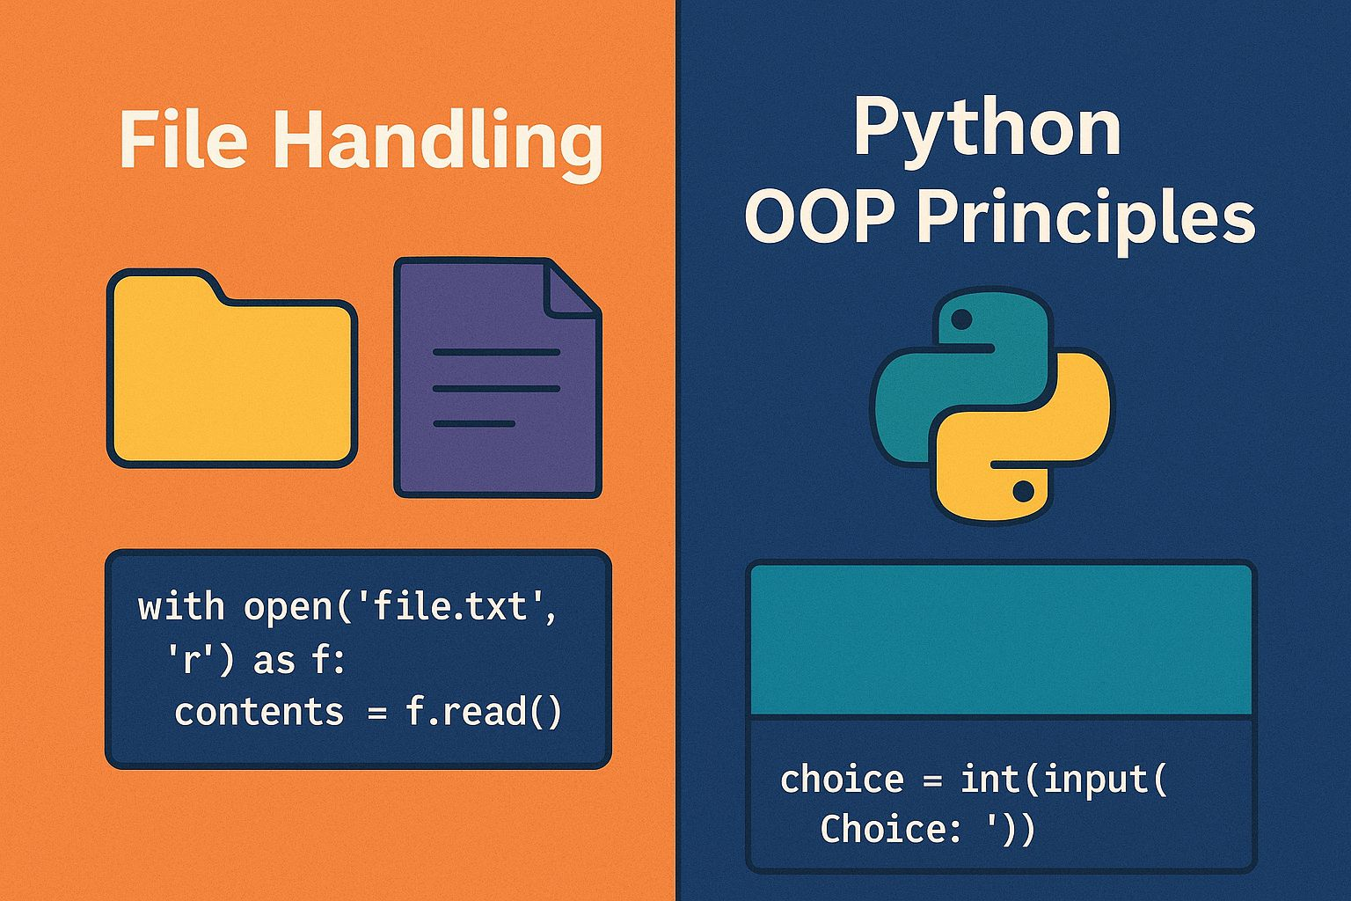
Concepts Used
Python OOP Principles:
Encapsulation → Each class manages its own data.
Abstraction → Users only interact via high-level methods.
Polymorphism – via method overriding (__str__).
Modular design → Separate Book, Member, and Library classes.
File Handling:
Persistent storage of books and members.
load() and save() methods handle reading/writing.

Slide 10
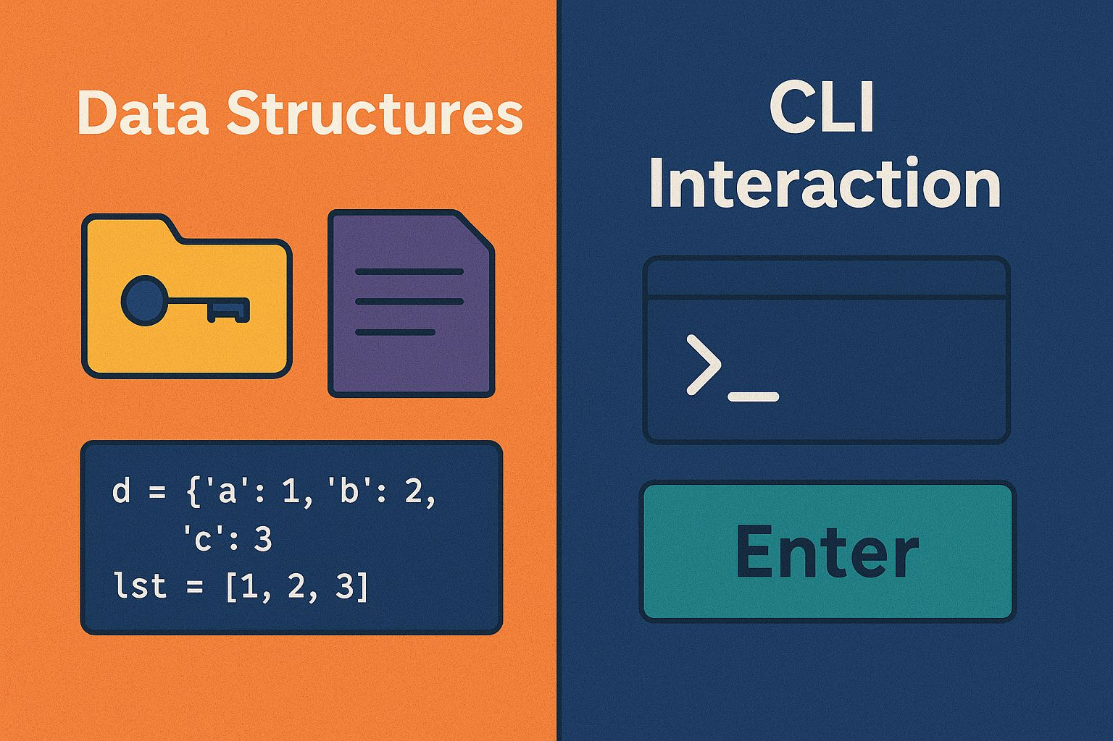
Concepts Used
Data Structures:
Dict → Store books and members using IDs as keys.
List → Track borrowed book IDs.
CLI Interaction:
Menu-driven input loop (while True:) using input().

Slide 11
Classes
Book Class
Attributes:
book_id, title, author, isbn,available
Methods:
to_line() → Convert object to file string
from_line() → Reconstruct object from file line
__str__() → Nicely format output for printing
-> This represents each book in the library with availability status.
Member Class
Attributes:
member_id, name, borrowed (list of book IDs)
Methods:
to_line() → Save member details to file
from_line() → Load member details from file
__str__() → Display readable member info
->This represents registered library members and tracks borrowed books.

Slide 12
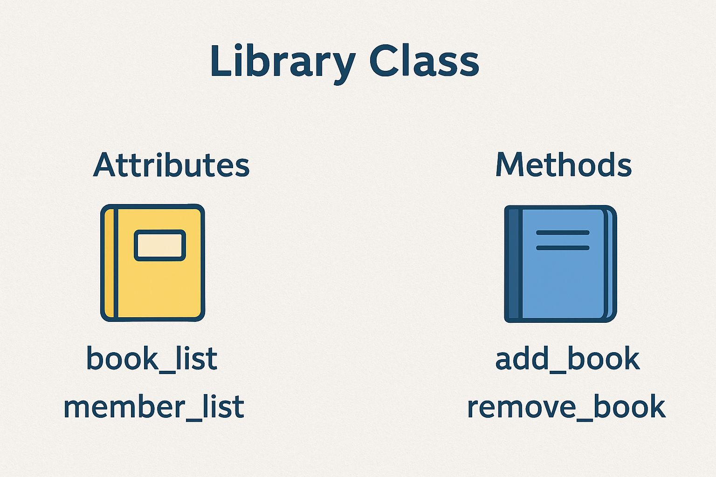
Library Class
Attributes:
books: Dict[str, Book] → All books
members: Dict[str, Member] → All members
Methods:
load() & save() → File persistence
add_book(), remove_book() → Manage inventory
register_member() → Add new members
borrow_book(), return_book() → Issue and return books
list_books(), list_members() → Display stored data
->This is used as a central manager that coordinates book and member operations.

Slide 13

->Why have we used exception handling in the project ?
To ensure corrupt data in files does not crash the system.
->Where it is used ?
Book.from_line() → Raises ValueError if line format is invalid.
Member.from_line() → Raises ValueError if line format is invalid.
Consider an example in our code :
if len(parts) != 5:
raise ValueError("Corrupt book line: " + line)
->Detects corrupt lines in books.txt or members.txt
Exception Handling

Slide 14
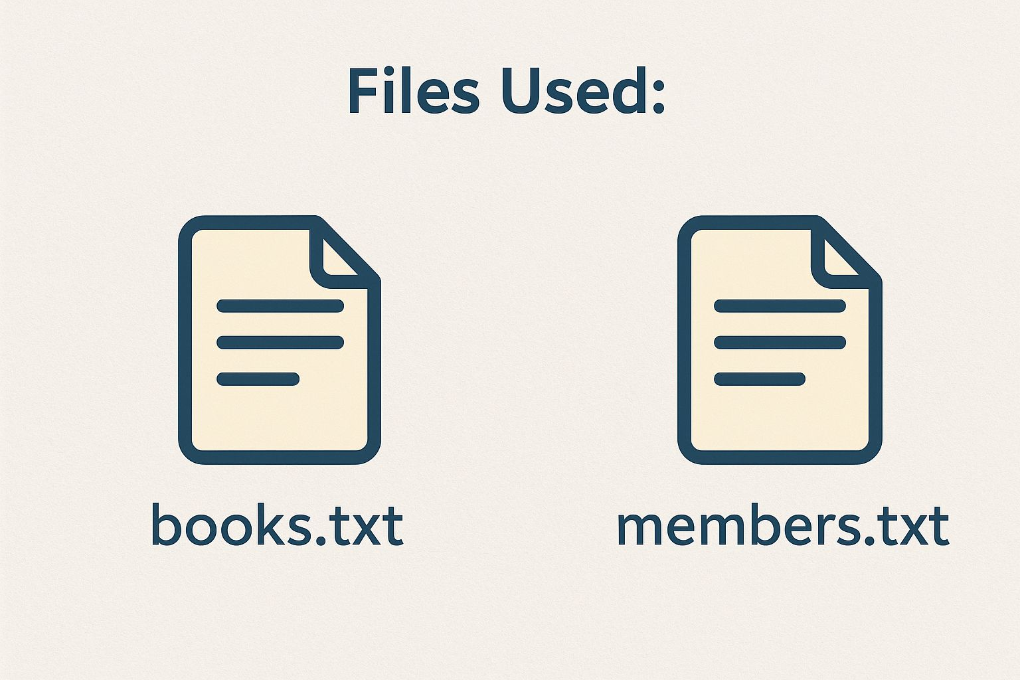
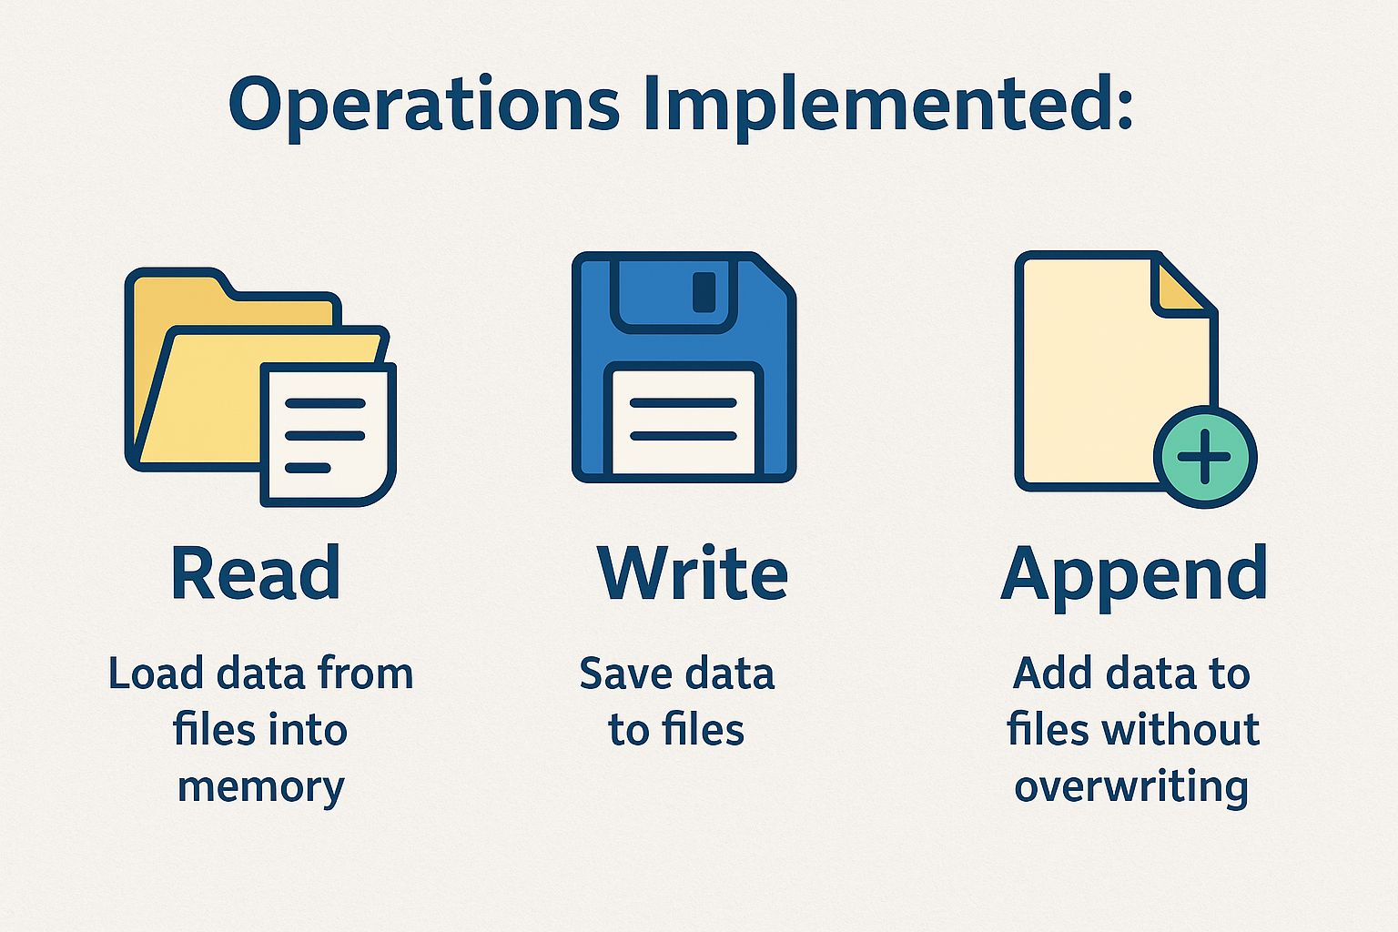
File Handling
Purpose: Store and retrieve book and member data persistently without using a database
Files Used:
books.txt → Stores book details (ID, title, author, availability)
members.txt → Stores member details (ID, name, borrowed books)
Operations Implemented:
Read: Load all books and members into memory at program start
Write: Save updates (borrow/return/add/remove) back to files instantly
Append: Add new books or members without overwriting data

Slide 15
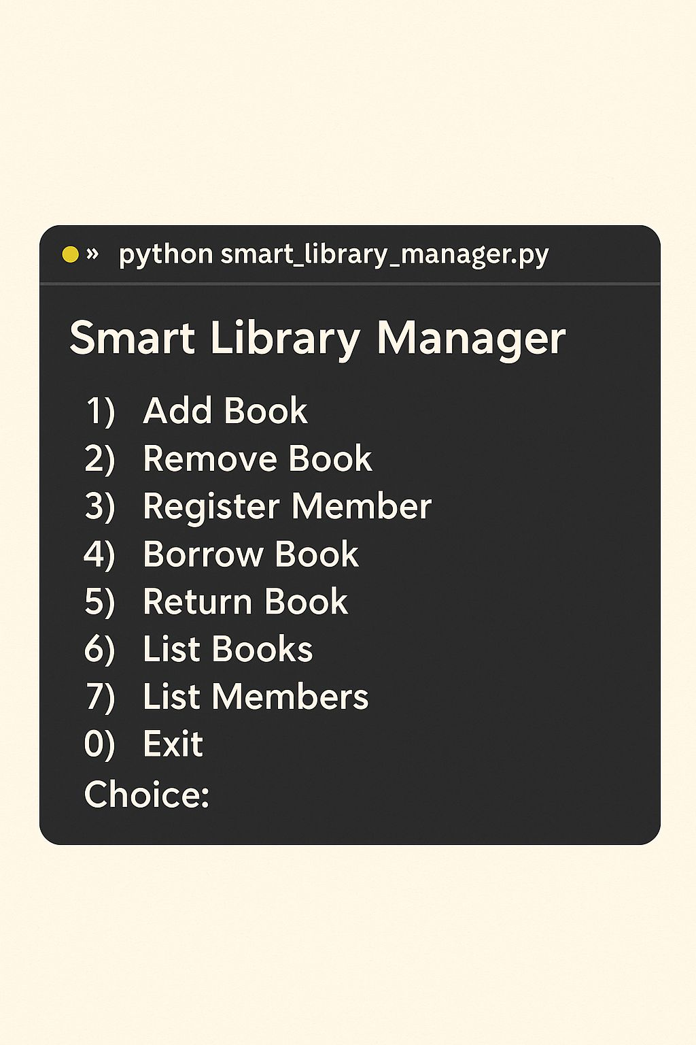
CLI Menu (run_cli)
Provides interactive user interface:
Add / Remove Book
Register Member
Borrow / Return Book
List Books / Members
Exit Program
Uses while True loop with input validation.

Slide 16
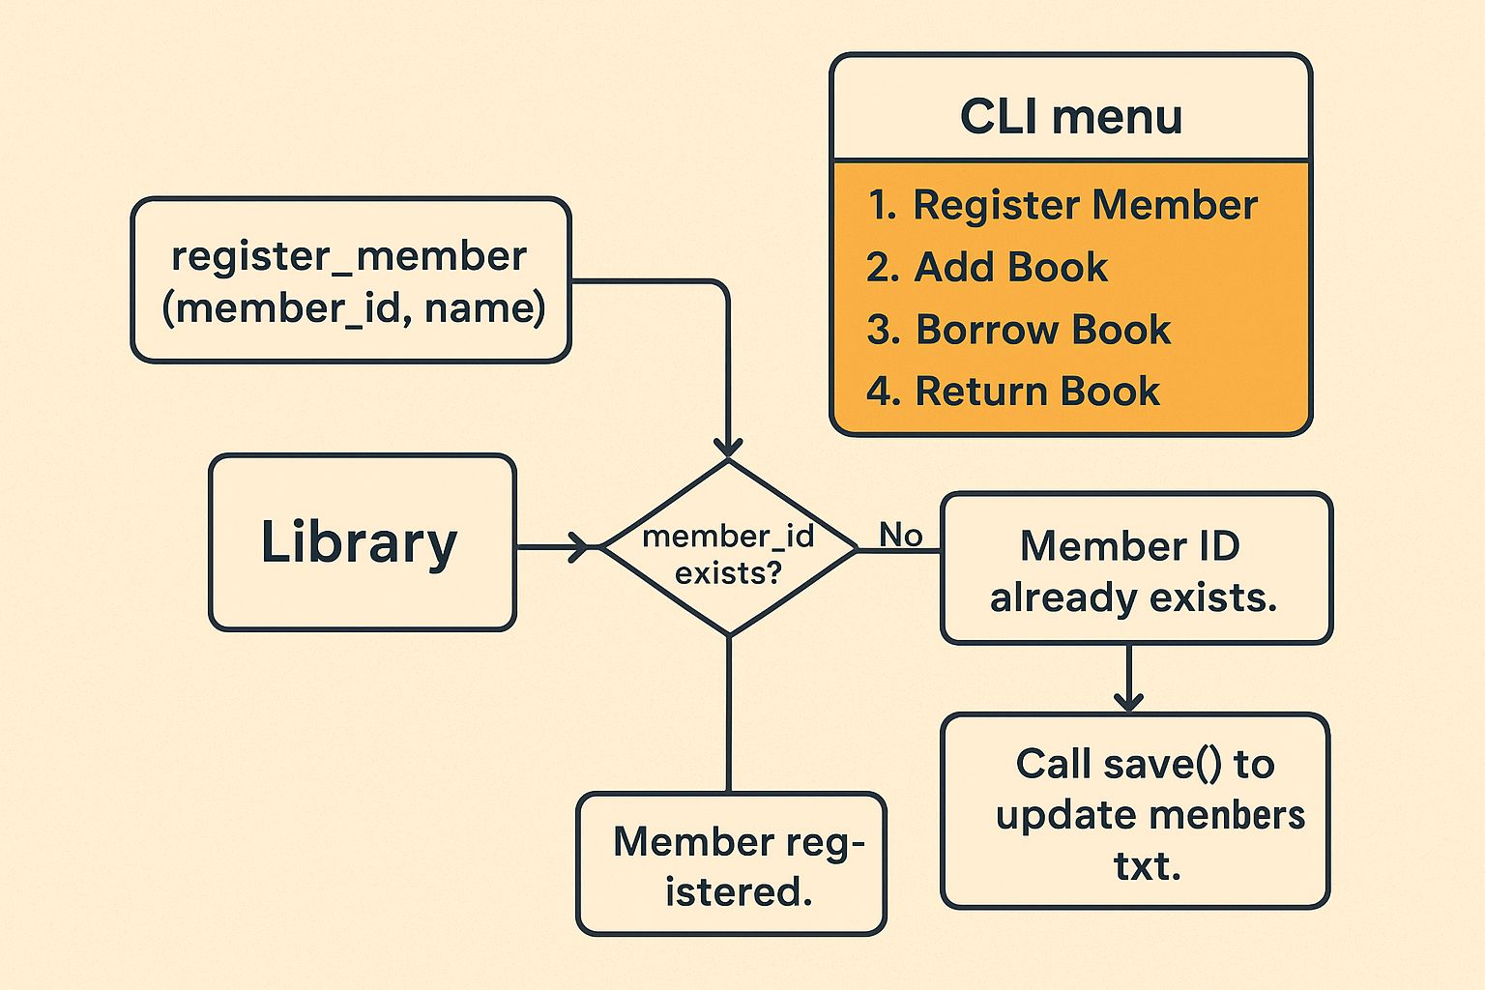
How Classes and Methods Work Together?
Register a Member
User selects “Register Member” in the CLI menu.
CLI calls register_member(member_id, name) in the Library class.
Library checks if member_id already exists in the members dictionary.
If yes → print "Member ID already exists."
If no → create a new Member object and store it inside self.members.
Call save() to update members.txt file with the new member details.
Print "Member registered."

Slide 17

Advantages of This Design
Modular and Structured: Easy to maintain.
Persistent Data: Stored in text files, survives restarts.
User-friendly: Menu-based interface.
Scalable: Can be upgraded to database or GUI with
minimal changes.

Slide 18

System Design Overview
Our project follows a modular, object-oriented design using three core classes and a CLI controller function.
Book class → represents individual book objects.
Member class → represents users of the library.
Library class → manages collections of books and members, handles borrow/return operations.
CLI (run_cli) → provides menu-driven interaction to trigger library operations.
Persistent Storage → uses text files to store books and members.

Slide 19
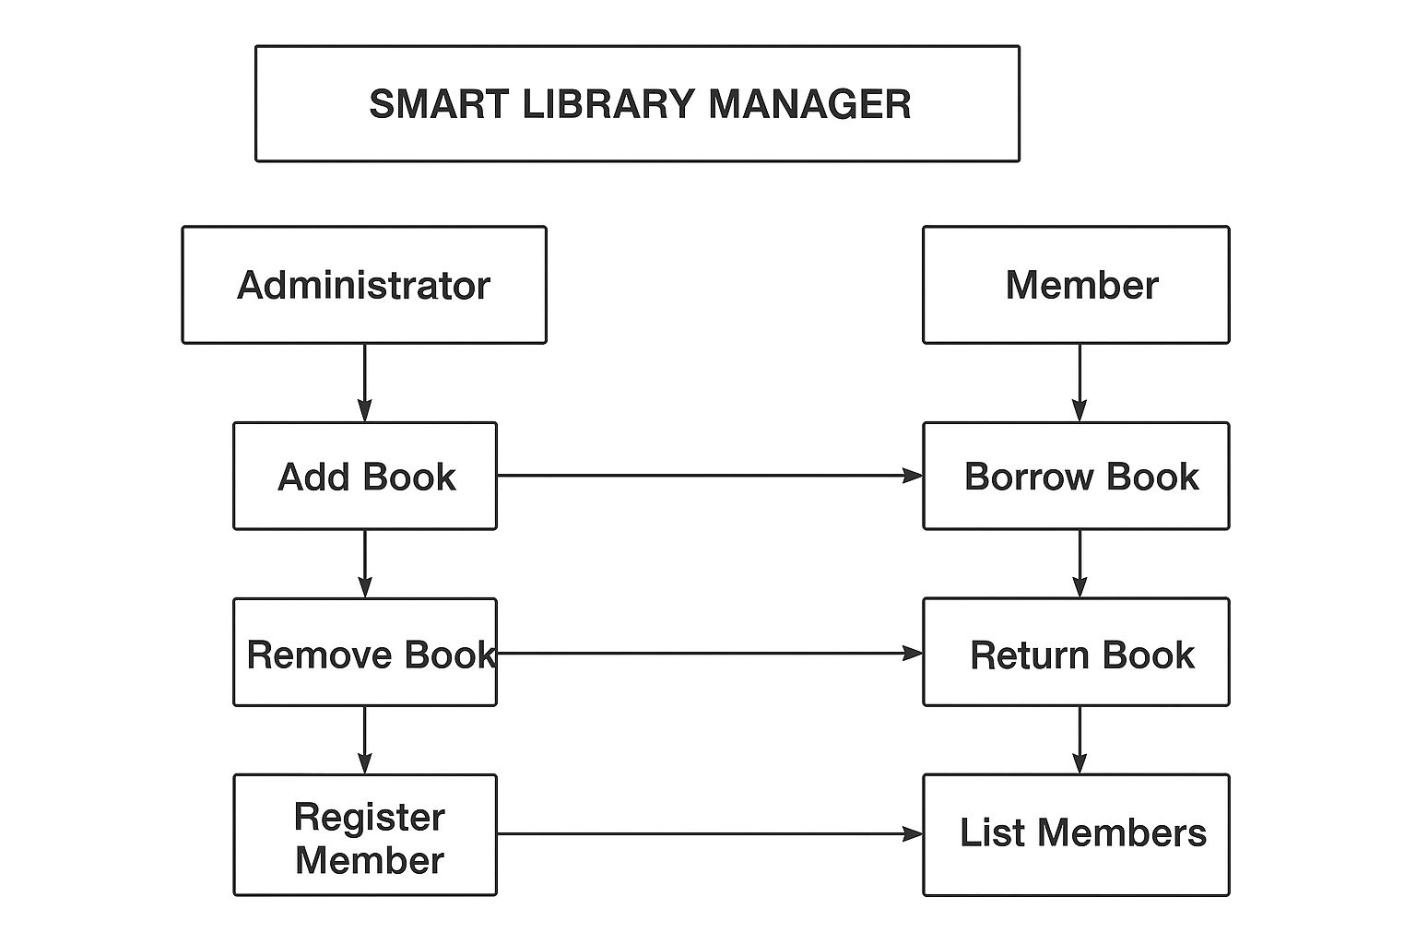
Flowchart-Design Flow

Slide 20
Conclusion
We have built a Smart Library Manager using Python, applying object-oriented programming principles and file handling to ensure persistent storage. The system demonstrates clean code design with a structured and modular approach, making it reliable and maintainable. It is simple to use while remaining flexible and easy to extend with new features, ensuring long-term scalability and adaptability.

Slide 21
THANK YOU

